Slide 1

Hw9 – Prediction Challenge
-Nitin Gowda

Slide 2
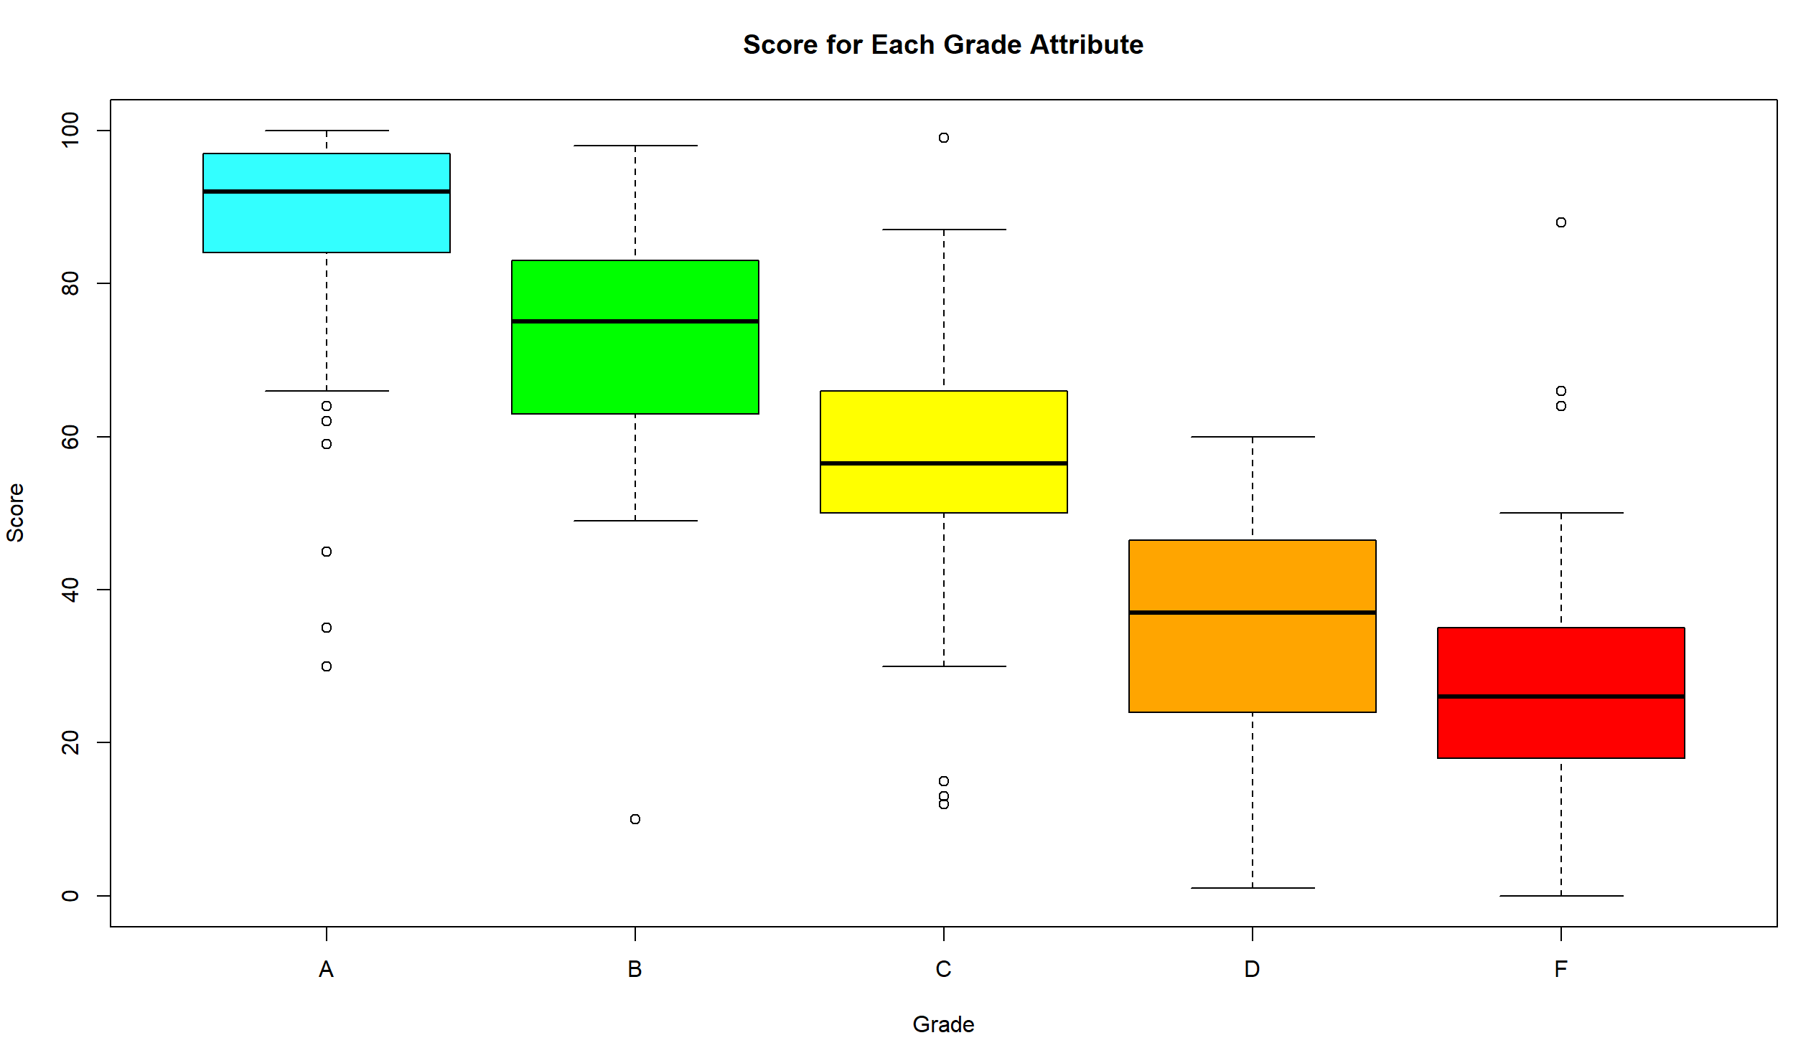
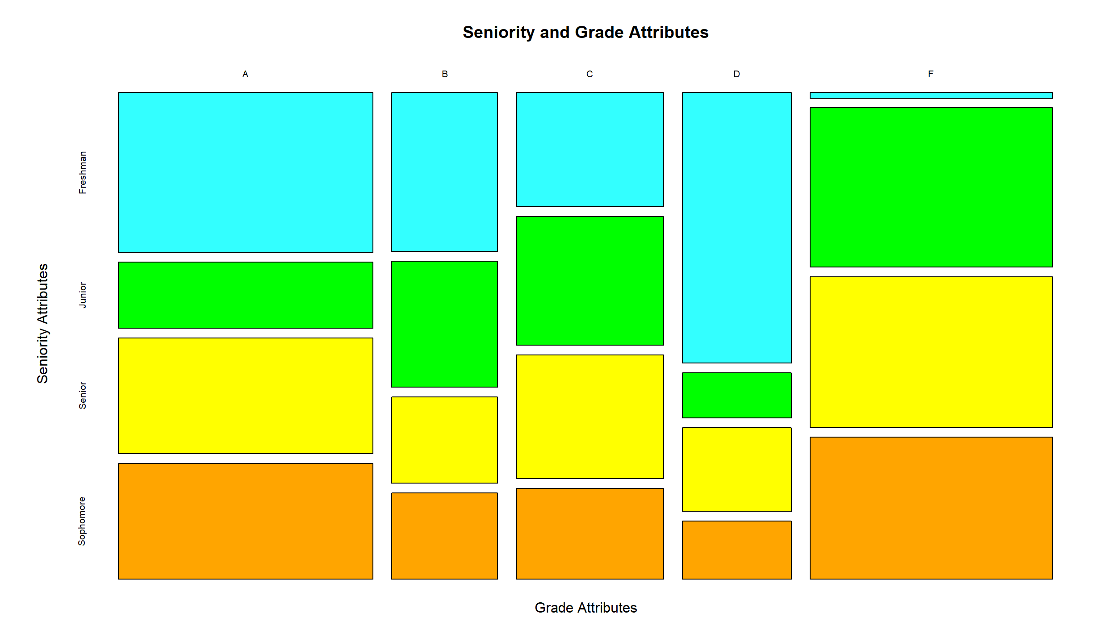
Overall score vs grade
Students who score above a 85 are very likely to get an A
Students who score above a 70 and below a 85 are very likely to get a B
Students who score above a 55 and below a 70 are very likely to get a C
Students who score above a 40 and below a 55 are very likely to get a D
Students who score above a 25 and below a 40 are very likely to get an F.
No freshmen get F.

Slide 3
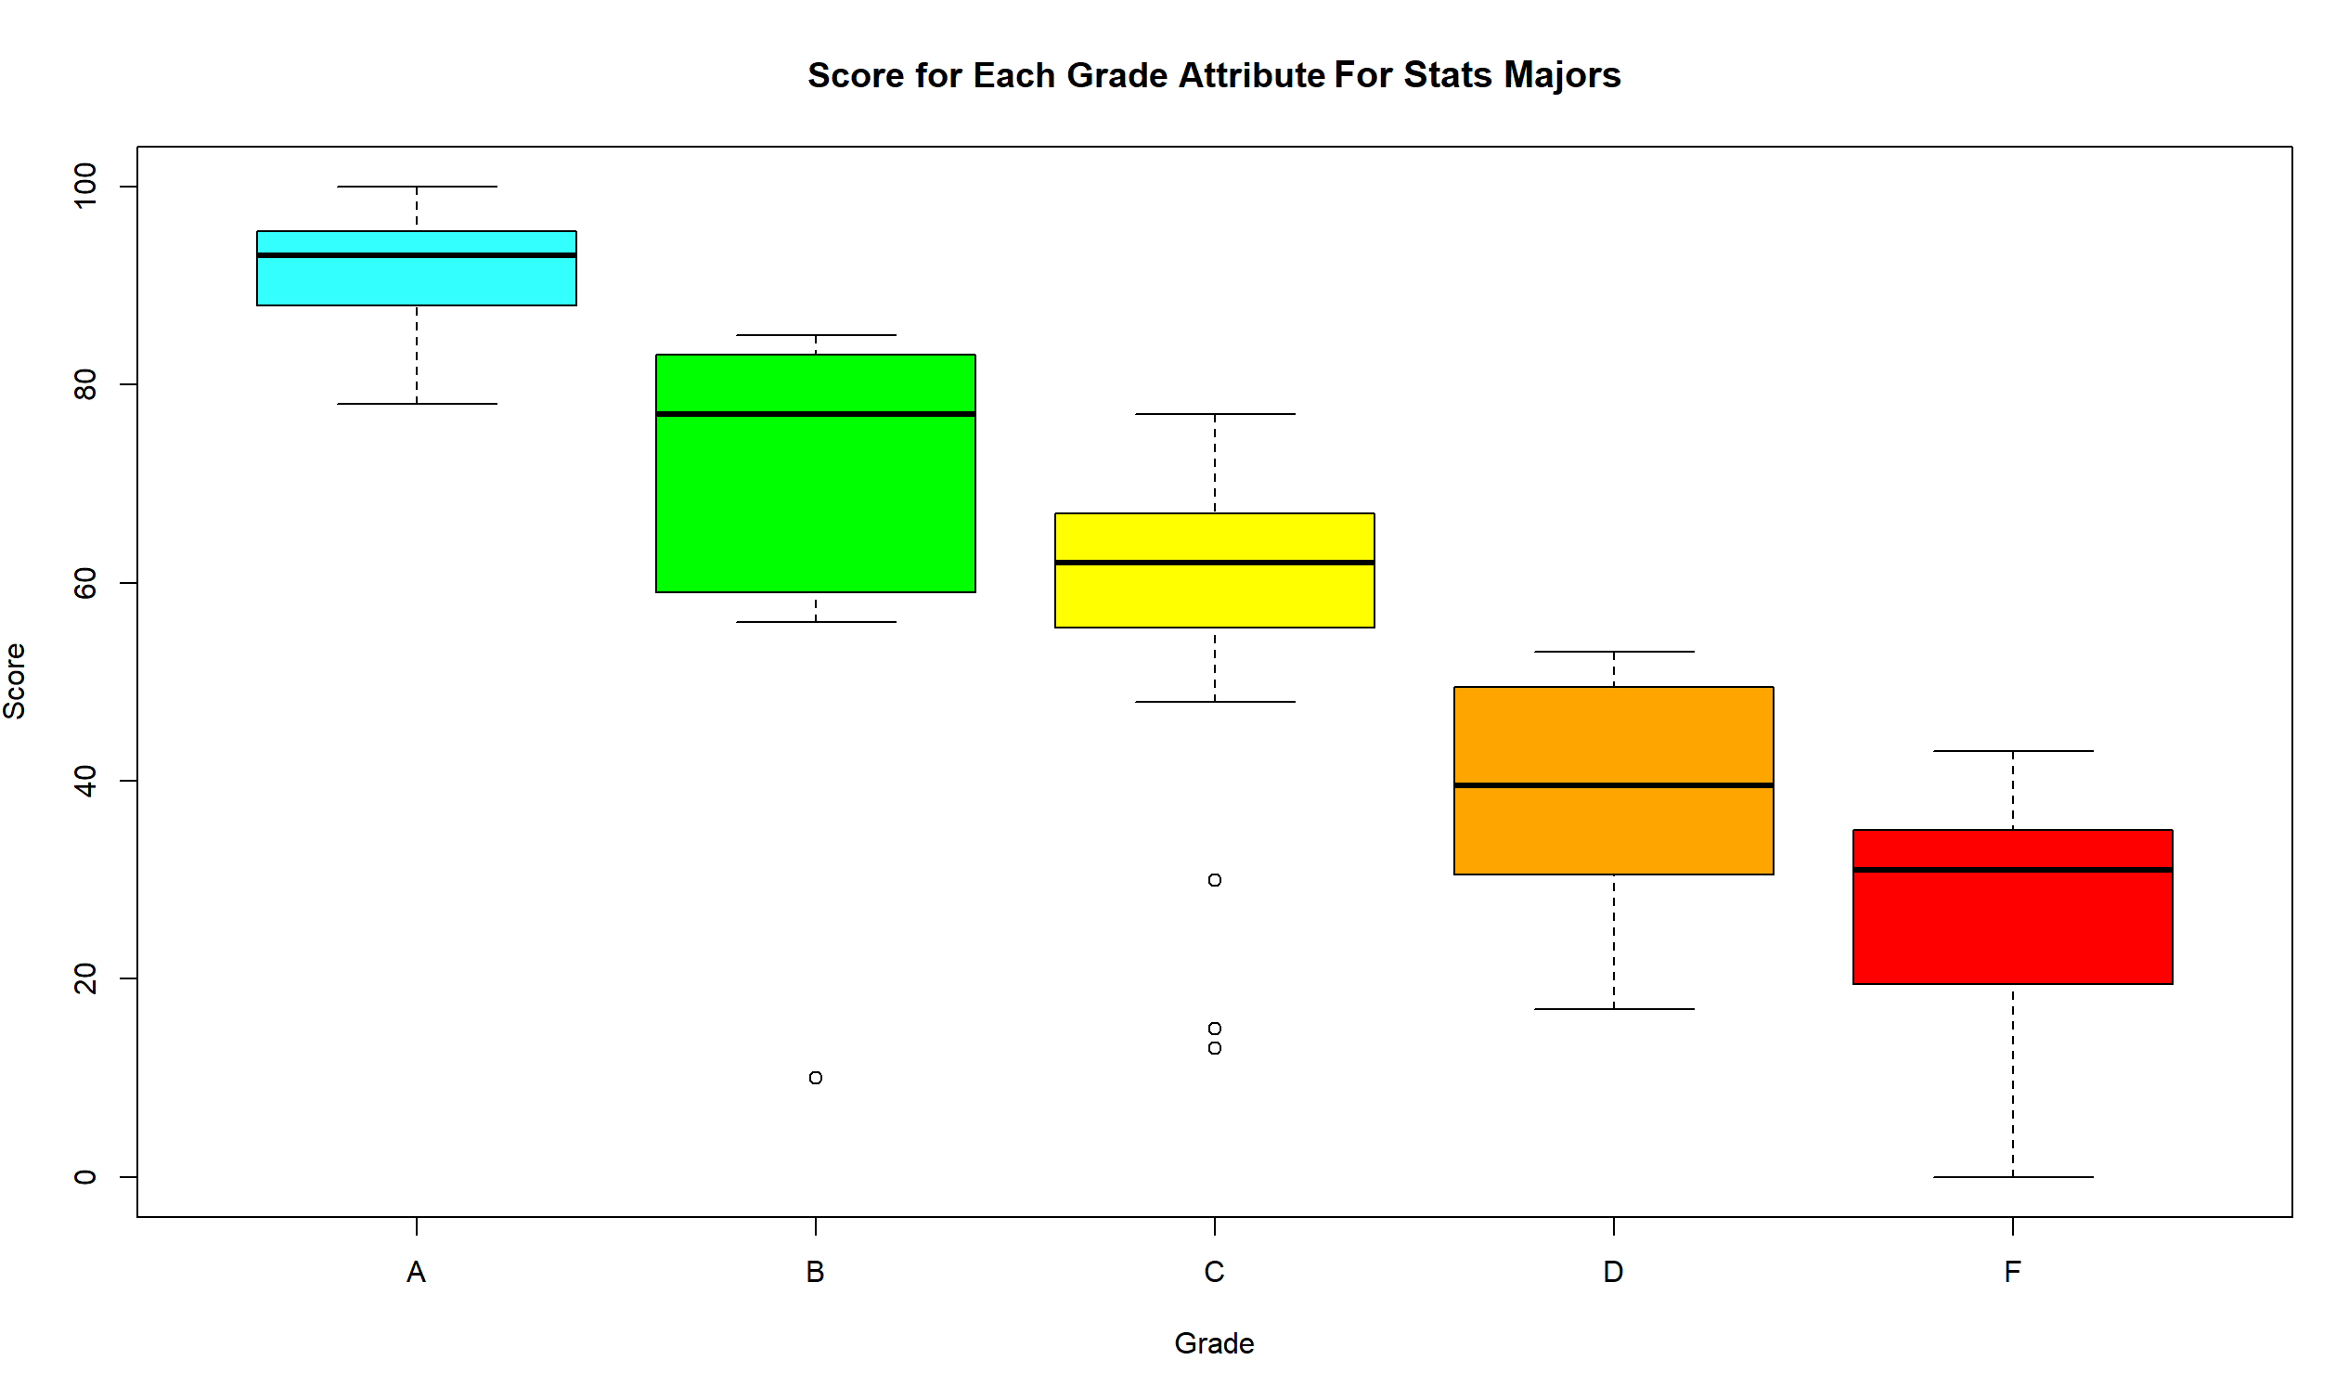
Analyzing stats
Students who score more than 90 get an A
Students who score more than 80 and less than 90 get a B
Students who score more than 70 and less than 80 get a C
Students who score more than 50 and less than 70 get a D
Students who score more than 40 and less than 50 get an F

Slide 4
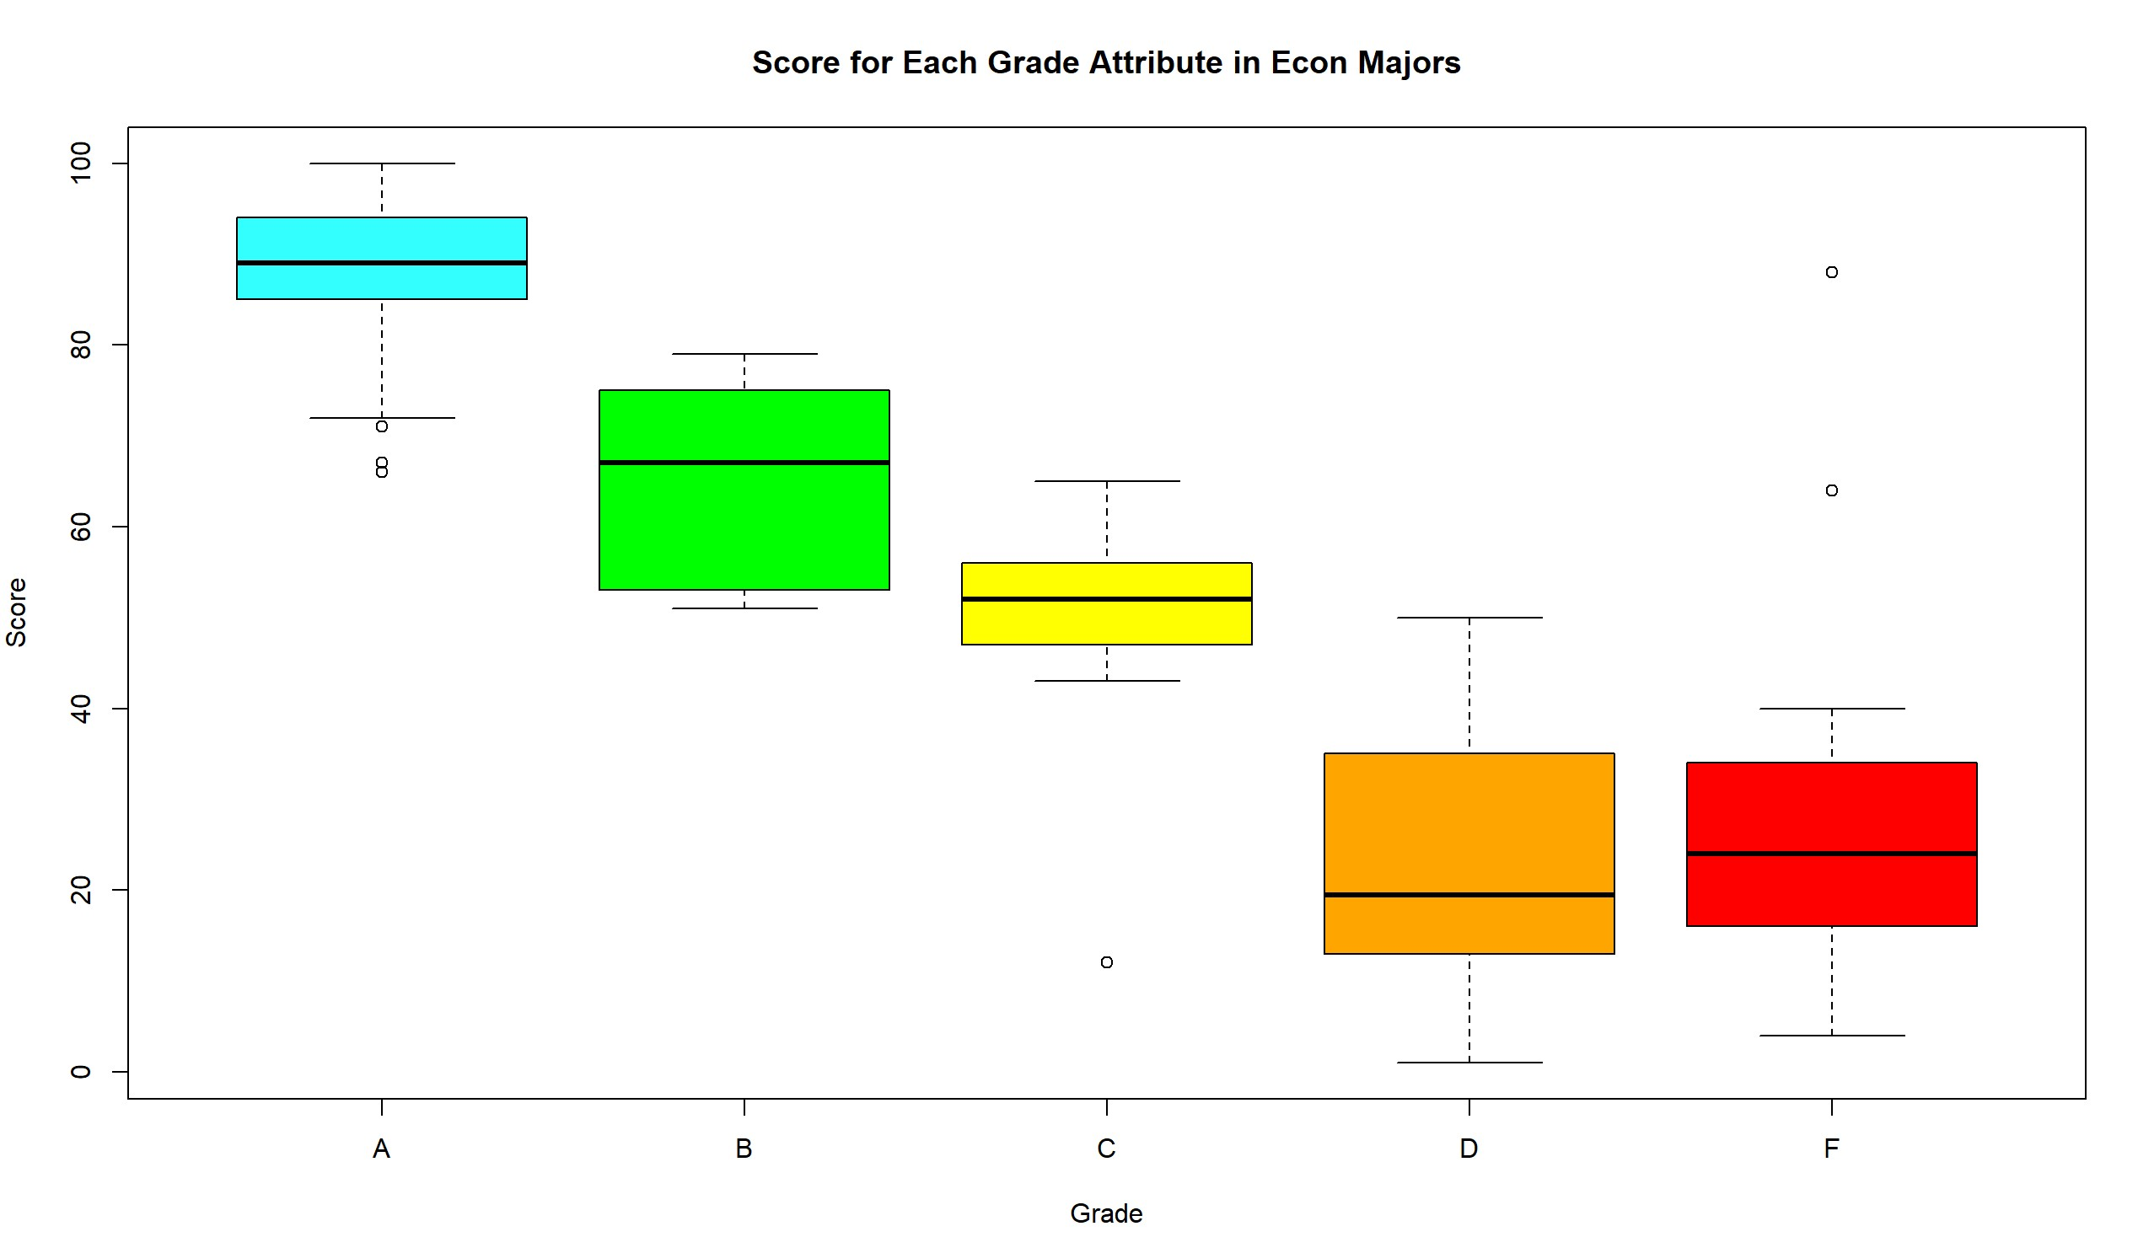
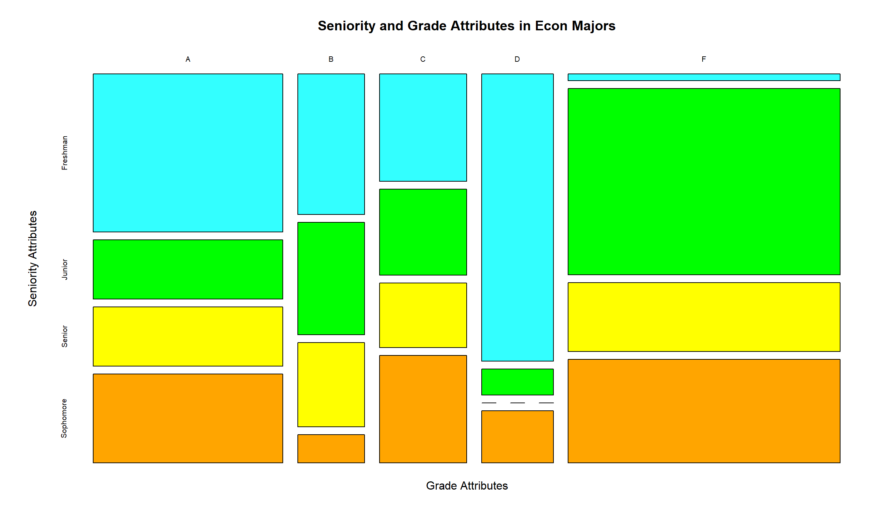
Analyzing econ
Students who score more than 85 get an A
Students who score more than 70 and less than 85 get a B
Students who score more than 55 and less than 70 get a C
Students who score more than 40 and less than 55 get a D
Students who score more than 25 and less than 40 get an F

Slide 5
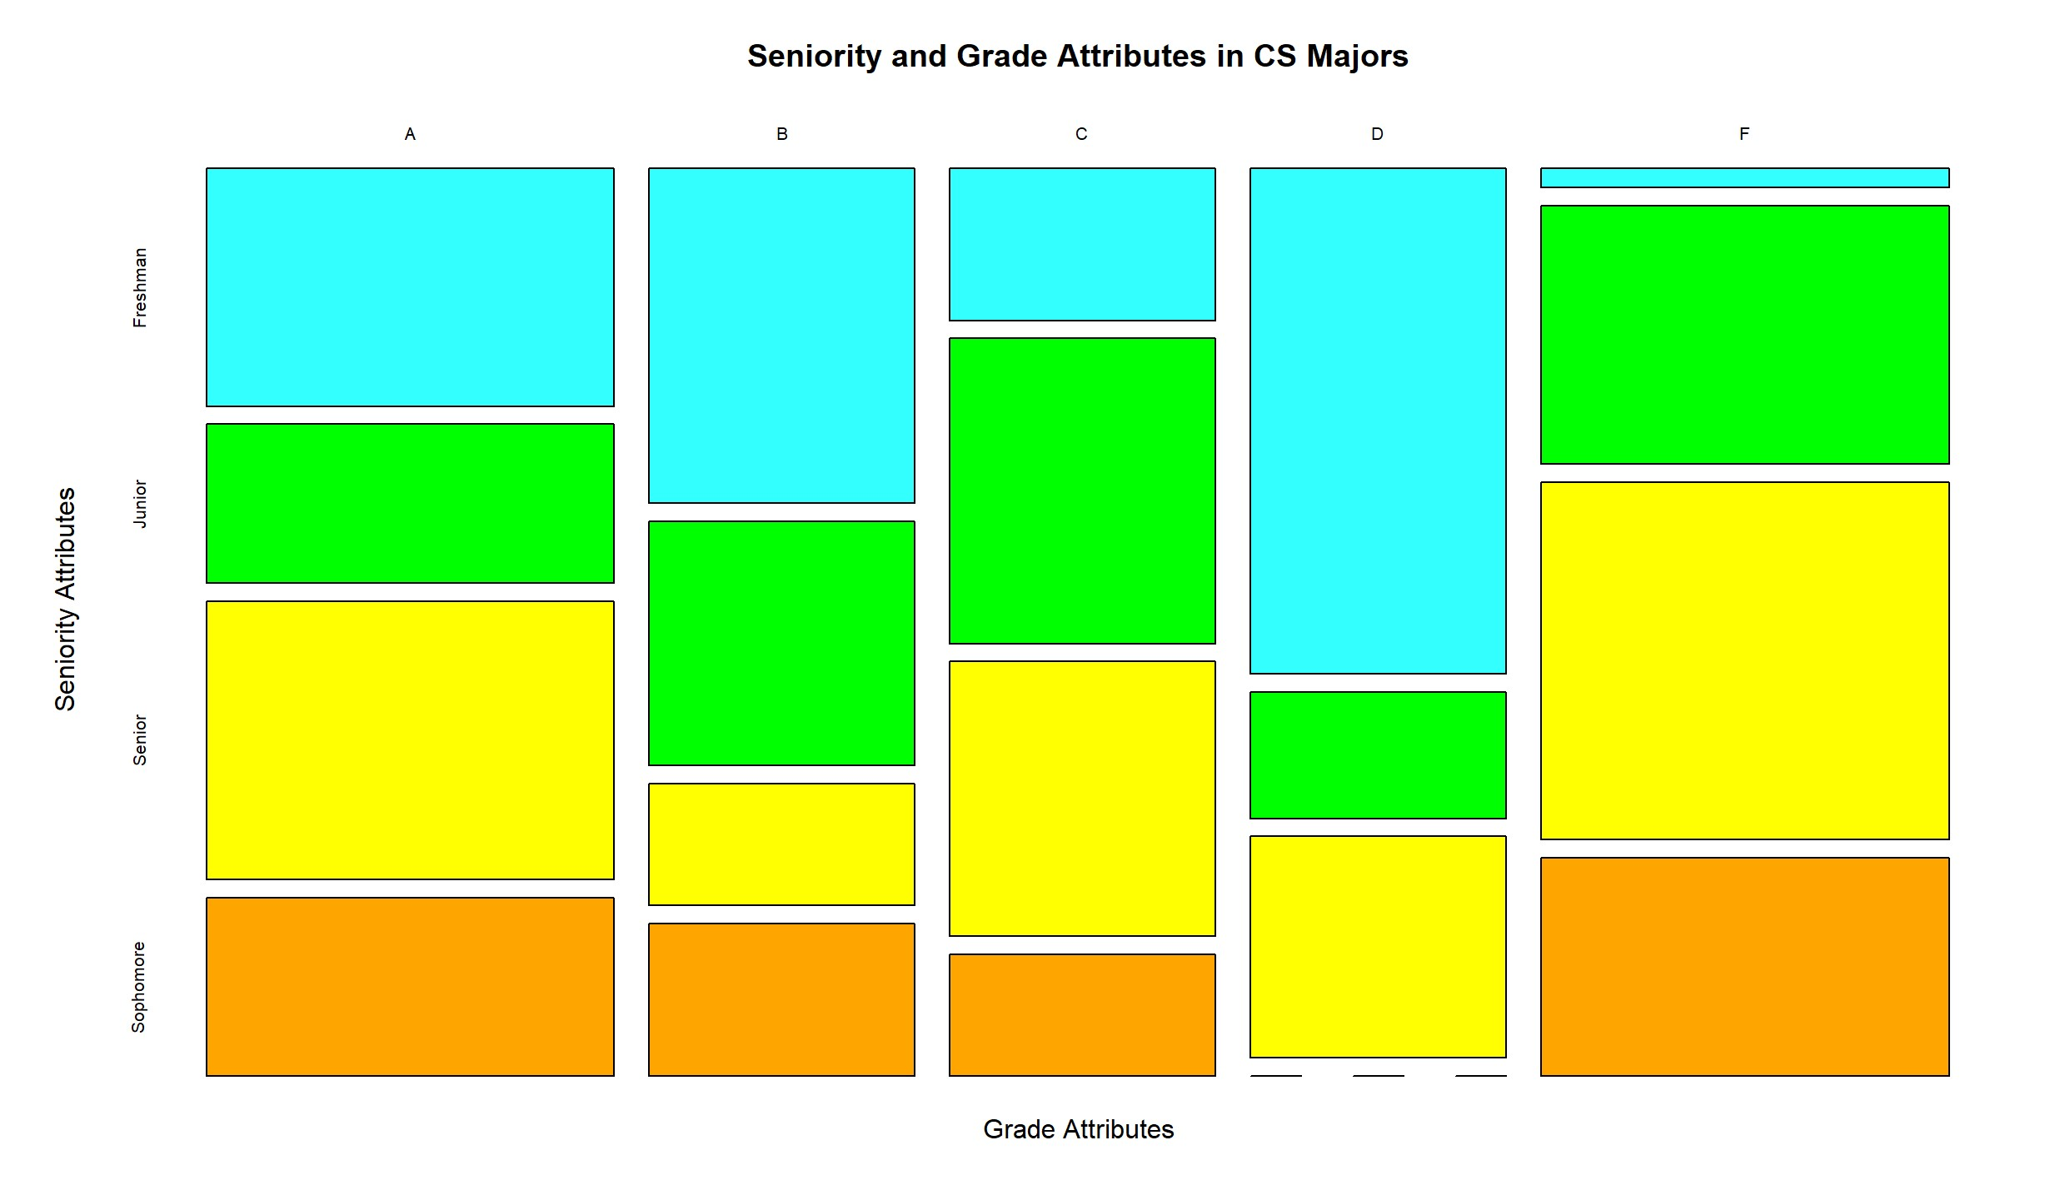
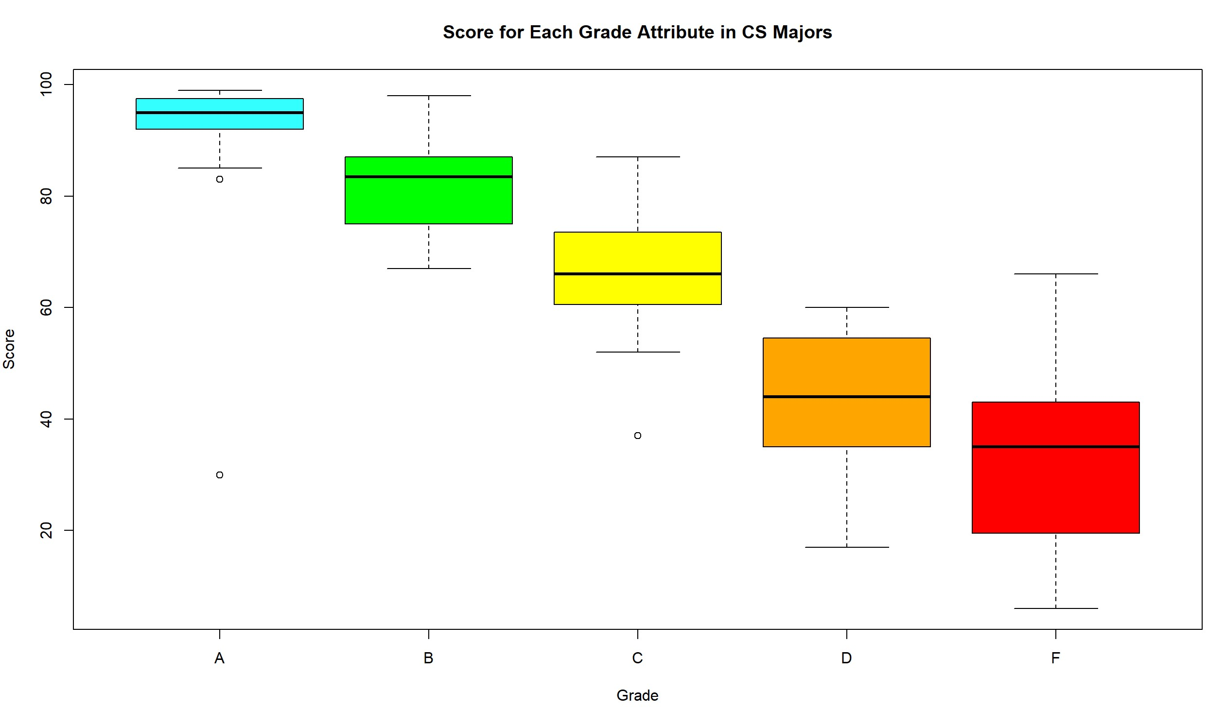
Analyzing CS
Students who score more than 90 get an A
Students who score more than 85 and less than 90 get a B
Students who score more than 70 and less than 85 get a C
Students who score more than 50 and less than 70 get a D
Students who score more than 40 and less than 50 get an F
sophomores dont get Ds

Slide 6
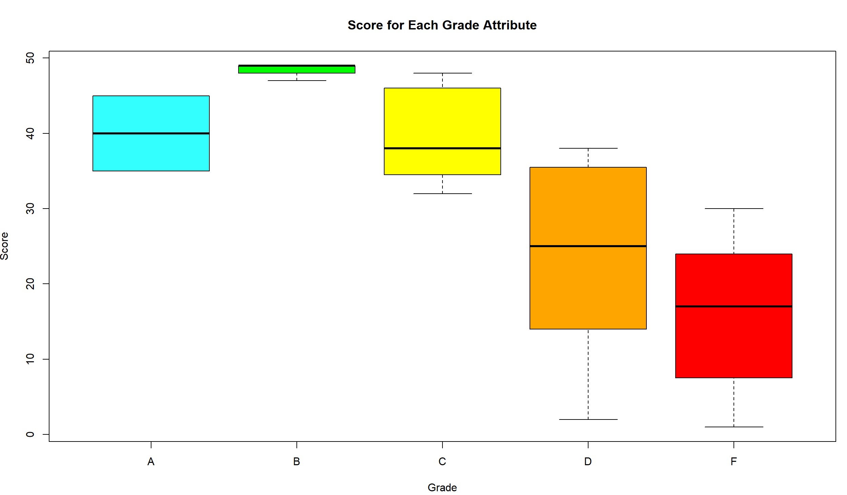
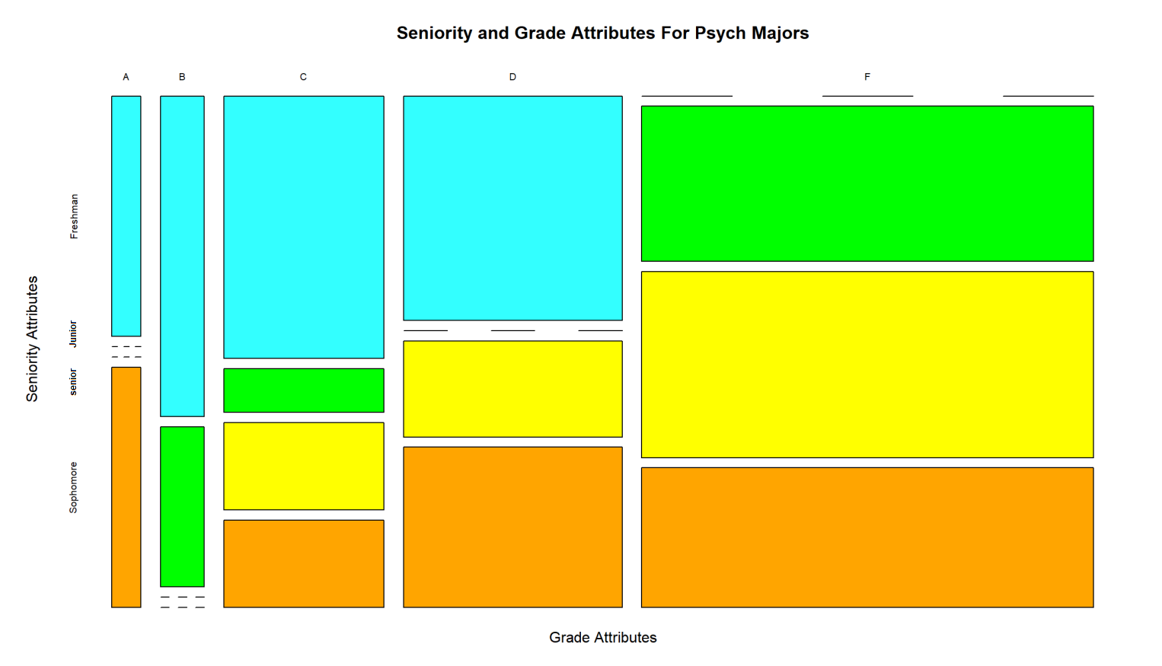
Analyzing psych
Psych box plots don’t give us too much useful information to work with other than students scoring more than 85 get As.
Mosaic plot tells us:
juniors and seniors dont get As
sophomores and seniors dont get Bs
Juniors dont get Ds
freshmen dont get Fs

Slide 7
Prediction model summary
Score ranges used in previous slides are considered.
All students above 85 get As
Most freshmen get Ds
No freshmen get Fs

Slide 8
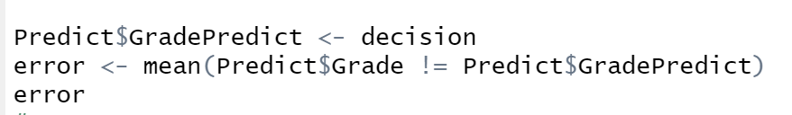
Error prediction
Ended with an error of 44%.

